Slide 1

LIBRARY MANAGEMENT SYSTEM
Name: SHARAN M
Batch: EB_JAVA 5768
Enrollment No: EBEON0721406147
Trainer: Santosh Mali

Slide 2
CONTENT
INTRODUCTION
SOFTWARES USED
HOME PAGE
ADMIN PAGE
BOOKS
TEACHERS LOGIN PAGE
STUDENTS LOGIN PAGE
SIGN UP PAGE
ADVANTAGE

Slide 3
INTRODUCTION
The library management system is a software to manage manual functions of a library.
The software helps to manage the entire library operations from maintaining book records to issue a book.
It enables librarians to easily catalog books and keep proper records of books issued, reissued, and those not returned.

Slide 4
SOFTWARE USED
HTML
CSS
JAVASCRIPT
JAVA
IDE REQUIRED:
ECLIPSE

Slide 5
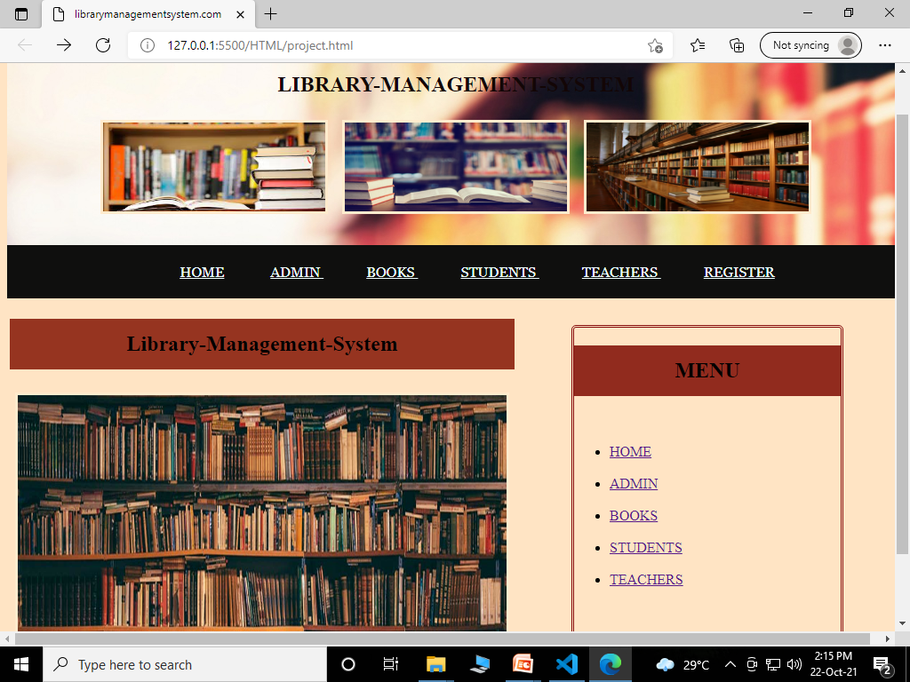
HOME PAGE

Slide 6
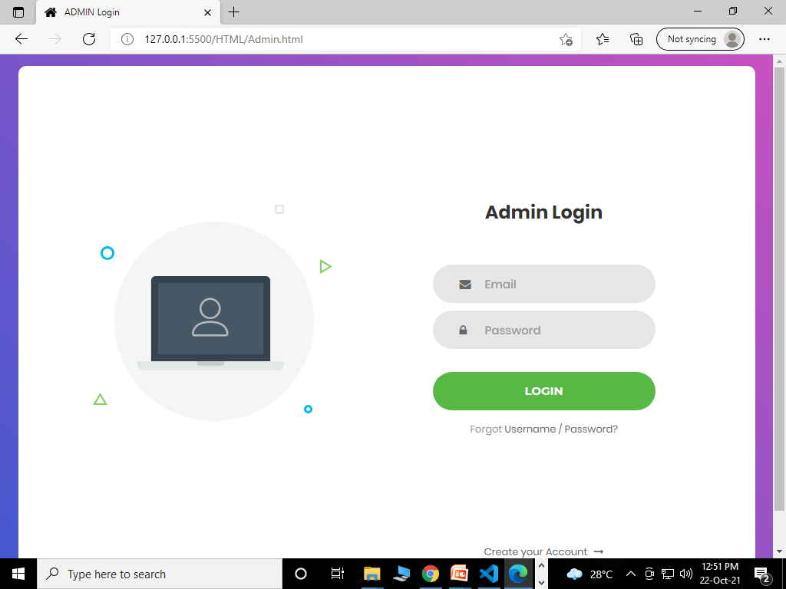
ADMIN PAGE

Slide 7
ADMIN LOGIN
The administrators can access the entire functionality of the system via this component.
The admin can maintain the records and track them as per necessity. Also, the admin can add or remove entries into the system respectively.

Slide 8
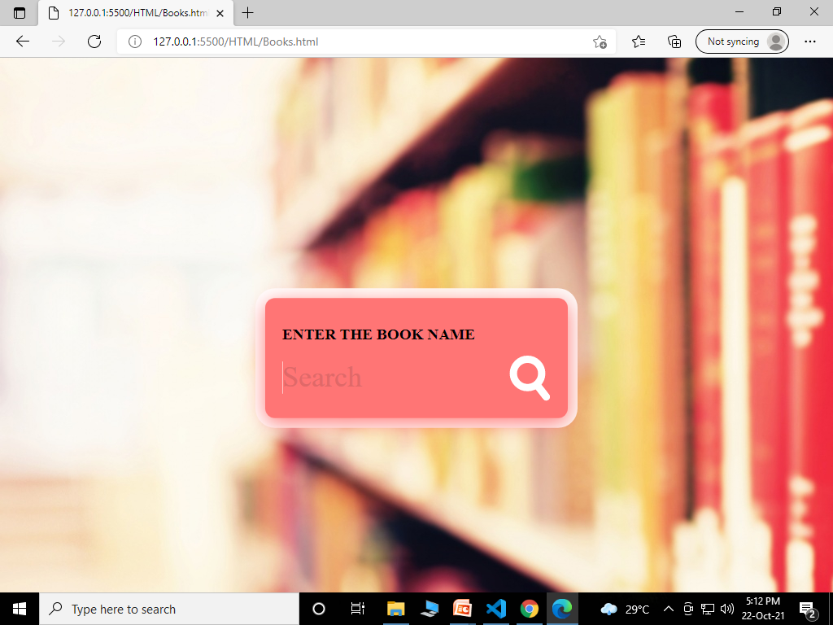
BOOKS

Slide 9
BOOKS PAGE
All users of the system, including admin can search for library materials.
Admin and students can search for books by entering the name of the book.

Slide 10
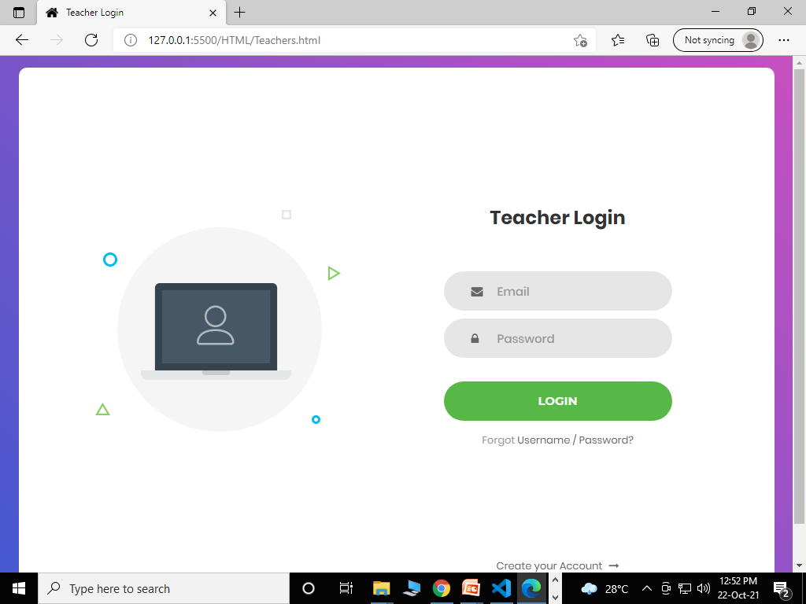
TEACHER LOGIN PAGE

Slide 11
LOGIN PAGE:
The teachers/students who want to access library materials, need to do registration first.
The registration allows for maintaining records accurately.
After registering, they can check out and check in the library material.

Slide 12
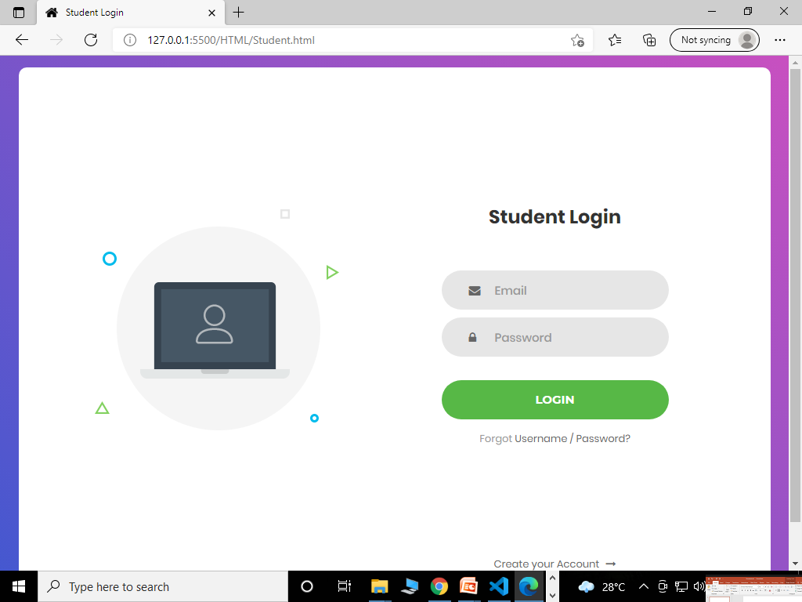
STUDENTS LOGIN PAGE

Slide 13
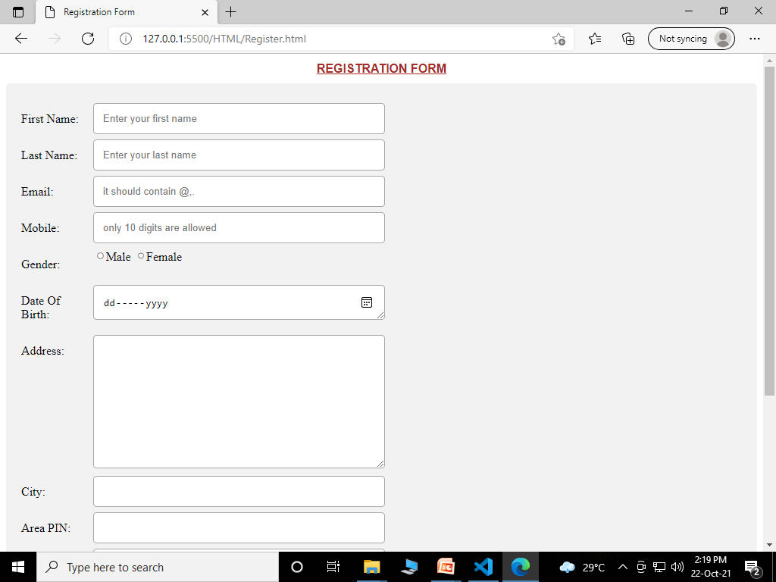
SIGN-UP FORM

Slide 14
SIGN UP PROCESS
A signup page is also known as a registration page.
Registration only happens the first time you access the system.
It is a way to check your credentials.
Every time after your initial registration, you will log on to the system using the username and password you created.

Slide 15
ADVANTAGE
Simple and easy to operate
Increase librarian’s efficiencies
Mobile access, anytime, anywhere
Search, add, update, and view library materials online
Helps to manage library functions constructively
Saves time and reduces overheads

Slide 16


